Slide 1



Plant Disease Detection Using Images
Team members:-
R.M.VIJAYBALAJI(2023peccs857)
V.Harish(2023peccs859)
Batch:-H10
Dept:-Computer science and engineering
Domain:-Machine Learning
Date:-
Venue:-CC1
Guide:Mr.Kadirvelu.G
Coordinators name:
Mr.Kadirvelu.G
Mr.Prabhu Shankar

Slide 2
INTRODUCTION
In India about 70% of the populace relies on agriculture. Identification of the plant
diseases is important in order to prevent the losses within the yield. It’s terribly
troublesome to observe the plant diseases manually. It needs tremendous quantity of
labor, expertize within the plant diseases, and conjointly need the excessive time
interval. Hence, image processing and machine learning models can be employed for
the detection of plant diseases. In this project, we have described the technique for the
detection of plant diseases with the help of their leaves pictures. Image processing is a
branch of signal processing which can extract the image properties or useful
information from the image. Machine learning is a sub part of artificial intelligence
which works automatically or give instructions to do a particular task. The main aim
of machine learning is to understand the training data and fit that training data into
models that should be useful to the people.

Slide 3
ABSRACT
Crop diseases are a noteworthy risk to sustenance security, however their quick distinguishing proof stays troublesome in numerous parts of the world because of the non attendance of the important foundation. Emergence of accurate techniques in the field of leaf-based image classification has shown impressive results. This paper makes use of Random Forest in identifying between healthy and diseased leaf from the data sets created. Our proposed paper includes various phases of implementation namely dataset creation, feature extraction, training the classifier and classification. The created datasets of diseased and healthy leaves are collectively trained under Random Forest to classify the diseased and healthy images. For extracting features of an image we use Histogram of an Oriented Gradient (HOG). Overall, using machine learning to train the large data sets available publicly gives us a clear way to detect the disease present in plants in a colossal scale.

Slide 4
SOFTWARE/HARDWARE REQUIREMENT
Tools required:
Software Requirements:
Front End – HTML, CSS, JavaScript
Backend – Node.js
Language – Python 3.12
Hardware Requirements
Hard Disk: 100 GB SSD or more
RAM: Minimum 8–16 GB
Processor: Dual-core or higher

Slide 5
PROPOSED SOLUTION
The proposed system will leverage multi-label classification algorithms in machine learning to analyze patient data (e.g., symptoms, vital signs, test results) and accurately predict the likelihood of various diseases in a single model.
1. Multi-Disease Detection in One Model (Multi-Label Classification)
Innovation: Traditional diagnostic tools are disease-specific. This system predicts multiple diseases at once using a single unified model.
2. Integration of Diverse Data Sources
Innovation: Combines structured data (e.g., symptoms, lab tests) with unstructured data (e.g., doctor's notes, medical images if available).
3. Explainable AI (XAI) Integration
Innovation: Uses tools like SHAP or LIME to explain why a prediction was made.

Slide 6
LITERATURE REVIEW
CNN architectures: Various CNN models like VGGNet, ResNet, Inception, MobileNet, and DenseNet are widely used, often achieving high accuracy rates, especially with large datasets.
Transfer learning: A common technique that reuses pre-trained models to accelerate training and reduce the need for extensive computational resources.
Smartphones: Offer a cost-effective and convenient solution for farmers to capture and upload images for diagnosis.
Unmanned Aerial Vehicles (UAVs): Drones equipped with multispectral, hyperspectral, and thermal sensors provide high-resolution images for monitoring large crop areas quickly.
Data Augmentation: Techniques like flipping, rotating, and zooming are used to increase the size and diversity of limited datasets, which helps prevent overfitting.

Slide 7
SYSTEM DESIGN
Encapsulation: Hiding a module's internal implementation details and exposing only what is necessary through a well-defined interface. This allows for changes within a module without affecting other parts of the system.
Low coupling: Ensuring that modules have minimal dependencies on each other. When coupling is low, a change in one module is less likely to cause a ripple effect of changes in other modules.
High cohesion: Grouping related functionalities within a single module to ensure it has a well-defined and focused purpose.
Interfaces: The communication channels that define how different modules interact with one another. A stable, well-documented interface is crucial for ensuring modules can work together seamlessly

Slide 8
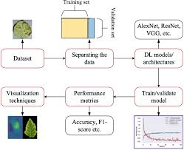
ARCHITECTURE DIAGRAM

Slide 9
IMPLEMENTATION PLAN
Gather a comprehensive dataset of images of healthy and diseased plant leaves (images can be sourced from publicly available datasets like PlantVillage or PlantDoc, or collected from field trials).
Ensure the dataset is diverse and representative of real-world conditions, including variations in lighting, angles, backgrounds, and plant varieties. Consider incorporating other contextual data, such as environmental conditions.
Step 1: Data acquisition
Step 2: Data preprocessing and augmentation
Step 3: Model training and evaluation
Step 4: Integration into an application

Slide 10
TESTING
Unit testing: Performed by developers, this involves testing the smallest individual units or components of a software application in isolation. Its purpose is to ensure that each unit functions correctly on its own.
Integration testing: This level checks how multiple units or modules work together as a group. It verifies the data flow and communication between components to ensure their interaction is seamless.
System testing: A separate quality assurance (QA) team tests the complete, integrated system to ensure it meets all specified requirements. This validates the overall functionality, performance, and security of the application in an environment that simulates the production environment.

Slide 11
FUTURE SCOPE/VISION
Long-Term MVP Objectives
Support for detecting diseases across various crops
Use advanced CNN architectures
Host the ML model on a scalable cloud platform to serve many users simultaneously in real-time.
Collaboration with NGOs (Non-Governmental Organizations)
Partnering with NGOs can significantly enhance the reach, adoption, and impact of your plant disease detection system, especially in rural and underserved farming communities.
Potential Roles:
Capture and upload plant images.
Train, evaluate, and deploy ML models
handle data preprocessing and improvement.

Slide 12
CONCLUSION AND FUTURE ENHANCEMENT
The use of deep learning and computer vision offers a powerful, automated approach to plant disease detection, providing a scalable and accessible solution for modern agriculture.
Real-world limitations: Models often perform with high accuracy on controlled datasets like PlantVillage but can struggle with the variability of real-world field conditions, including inconsistent lighting, complex backgrounds, and early-stage disease symptoms.
Dataset issues: A lack of sufficiently large and diverse datasets, especially for less common plant species or diseases, remains a challenge.
Technological limitations: Deployment can be limited by the high computational cost of training and the need for robust connectivity in remote farming areas.
Ethical considerations: Issues concerning data privacy, the equitable distribution of technology among farmers, and the transparency of AI-driven recommendations must be addressed for responsible implementation.

Slide 13
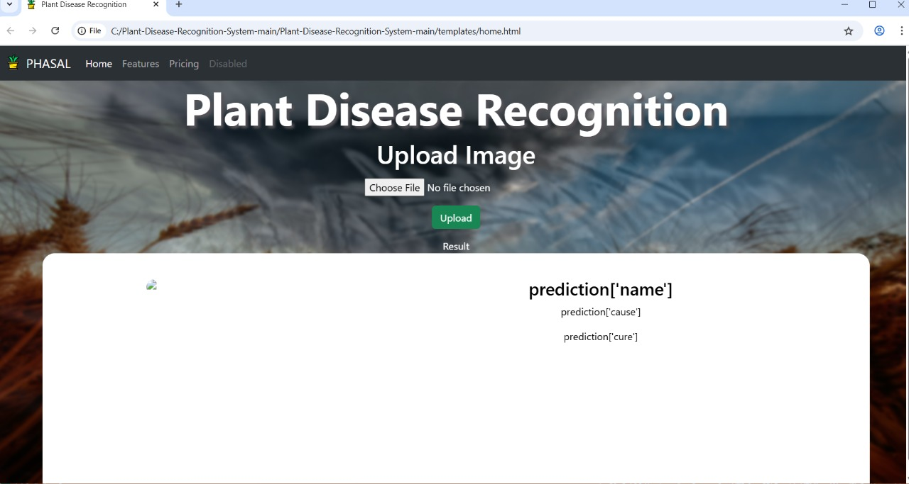
SCREENSHOTS OUTPUT

Slide 14
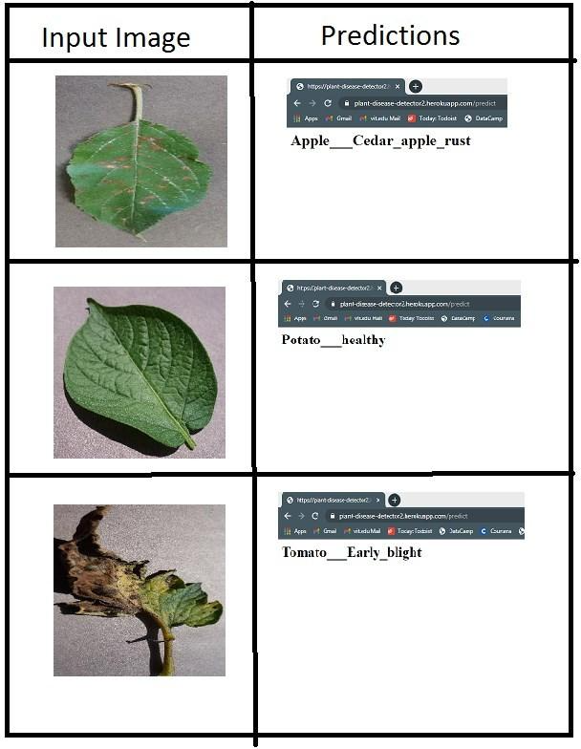

Slide 15
REFERENCES
A review paper titled "Image-based crop disease detection using machine learning" offers a comprehensive overview of cutting-edge techniques and methodologies in this field.
Another review focusing on advancements in deep learning applications for plant disease detection explores the limitations of traditional methods and discusses the potential of DL techniques like image classification, object detection, semantic segmentation, and change detection.
A publication by S. D. Khirade and A. B. Patil titled "Plant Disease Detection Using Image Processing," 2015 provides insights into techniques like Otsu's thresholding, boundary and spot detection, and feature extraction for plant disease detection.
A recent review from May 2025 discusses automated plant disease detection using ML and DL, highlighting limitations and suggesting solutions.
Links:
https://github.com/spMohanty/PlantVillage-Dataset
https://github.com/Spandan-Madan/PlantDiseaseDetection
text books:
Hands-On Machine Learning with Scikit-Learn, Keras, and TensorFlow
Deep Learning for Computer Vision

Slide 16
PUBLICATION DETAILS
Prepared for:
Plant disease detection using Images in ML
Department of Computer Science & Engineering
Year: 2025

Slide 17
THANK YOU

